Slide 1

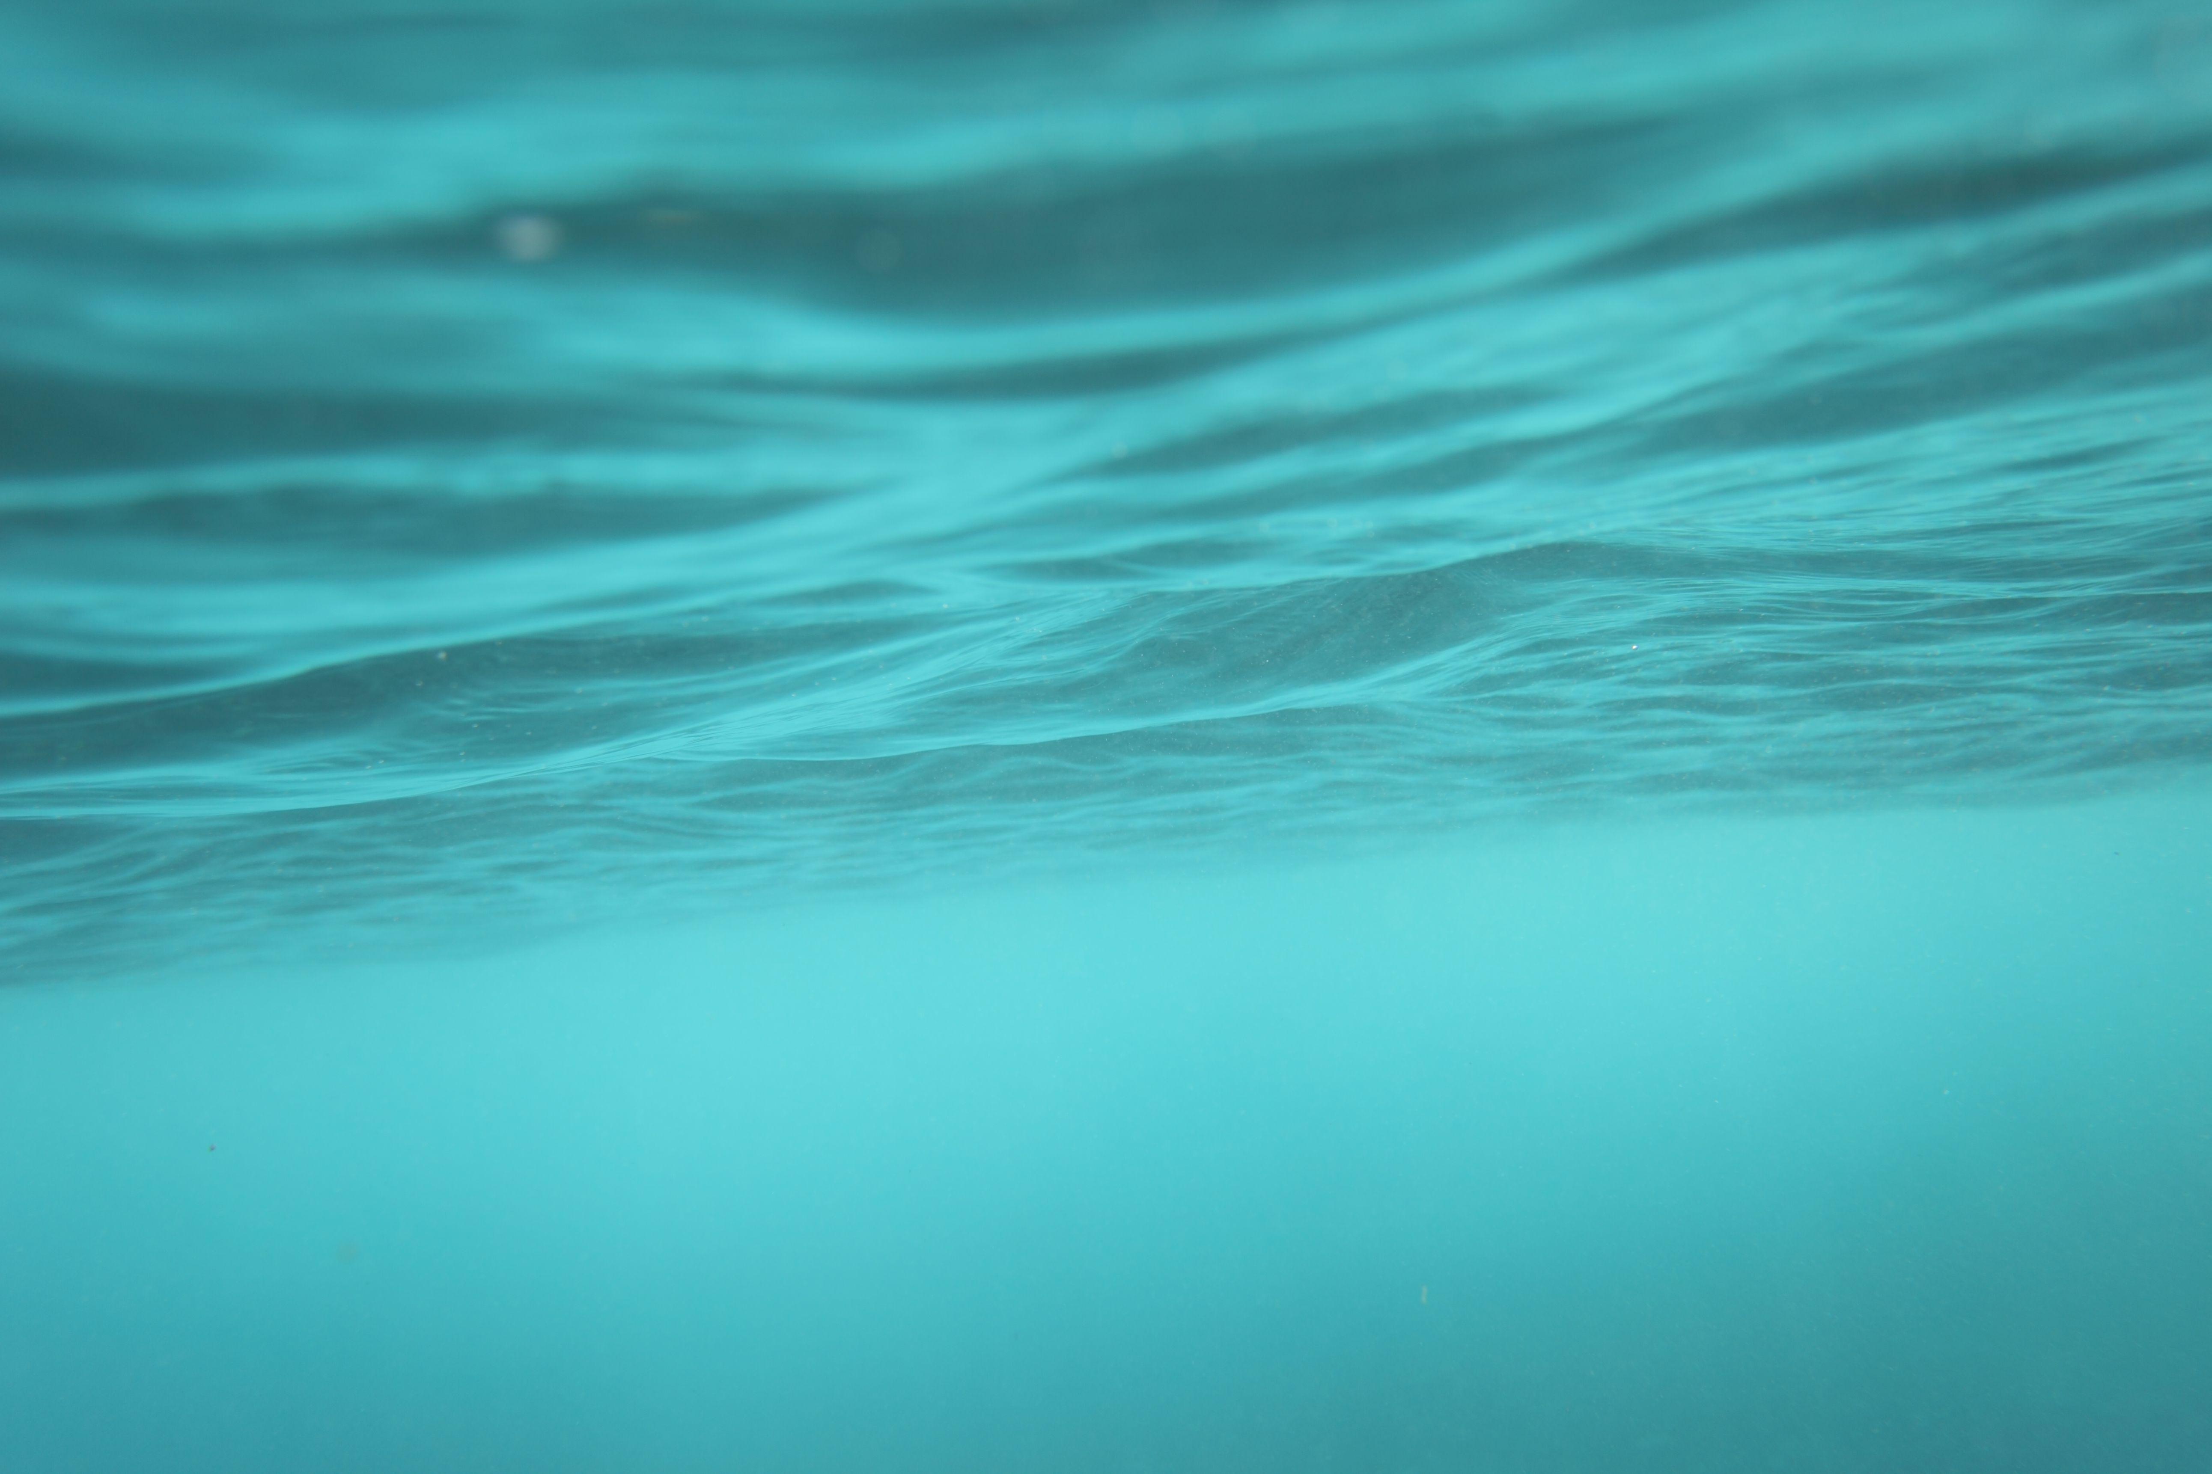
Water Level Sensor
Michael Surbeck

Slide 2
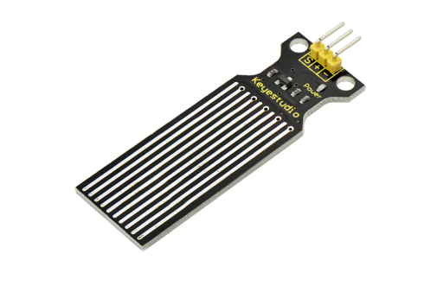
Sensor Fundamentals
Keystudio Ks0048 Water Sensor
Designed to measure a volume of water or to detect the presence of water.
By measuring the resistance of the several traces of exposed parallel wires the sensor can detect of water has entered an area and give a digital reading from an analog input. Higher levels of water mean lower resistance.
By measuring voltage the water level can be determined.

Slide 3
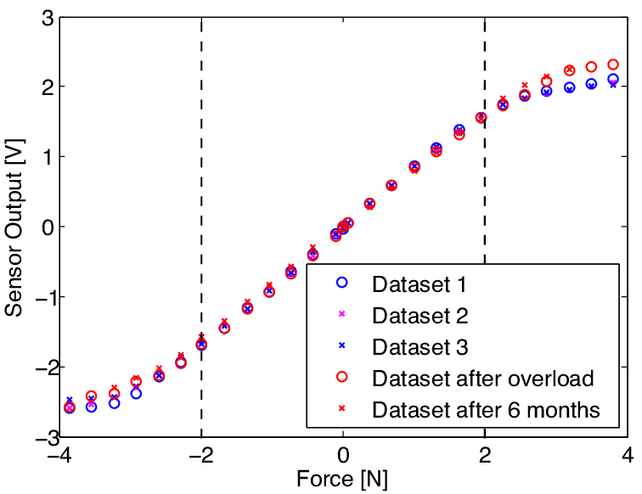
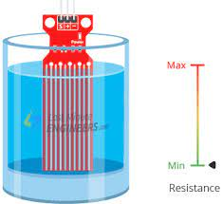
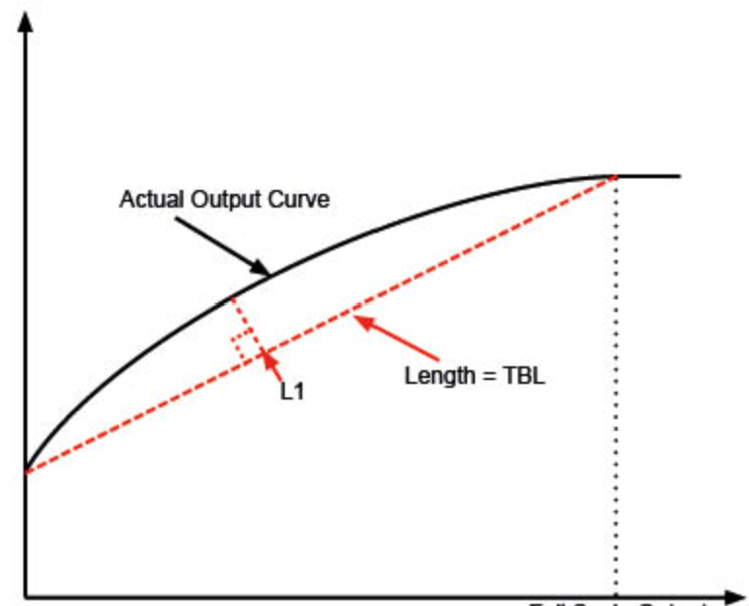
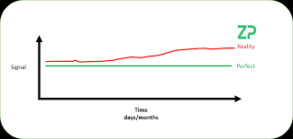
Important Characteristics
Repeatability
Drift
Range
Linearity

Slide 4
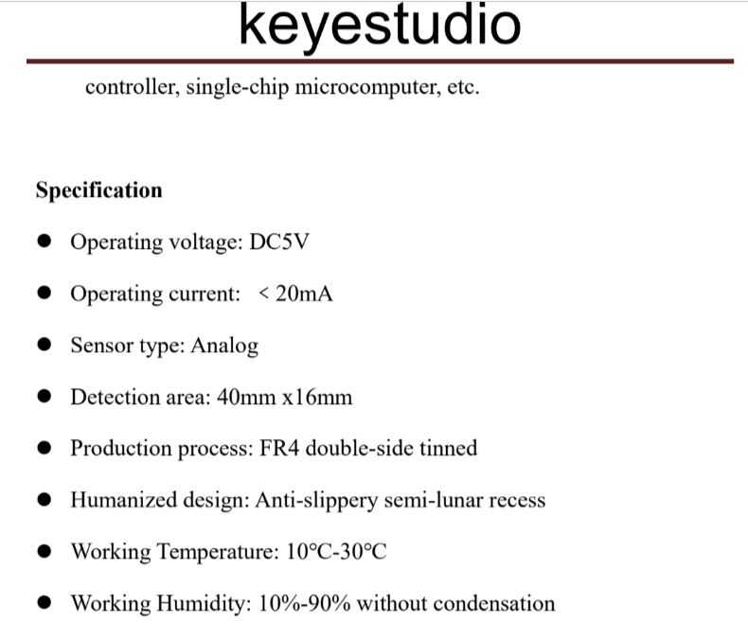
Data Sheet

Slide 5
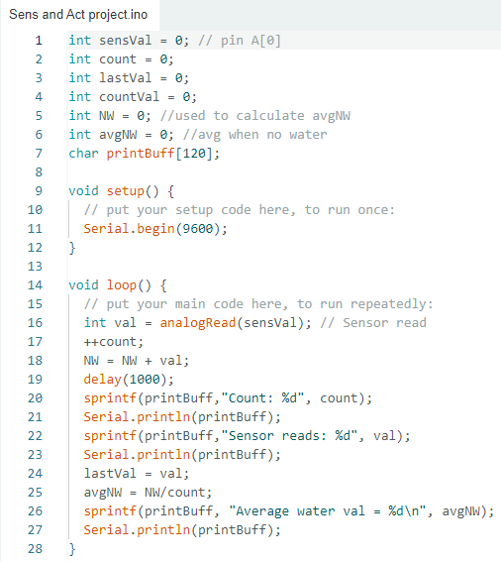
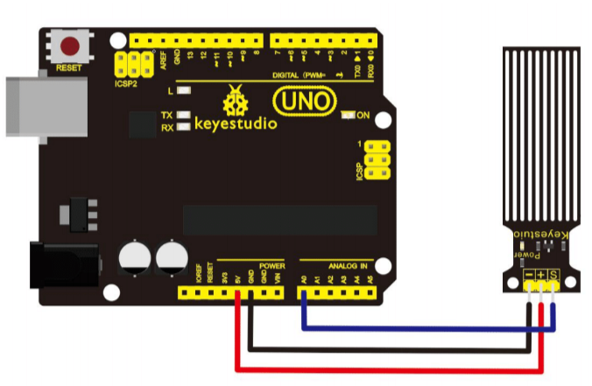
Code & Setup
Code:
Wiring Diagram:

Slide 6
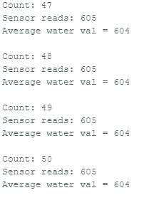
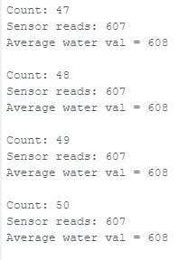
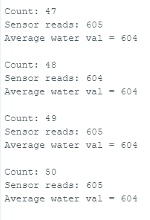
Repeatability
The sensor was submerged in a known quantity of water and left to sit for a predetermined period of time.
Repeated to find the sensor’s repeatability.

Slide 7
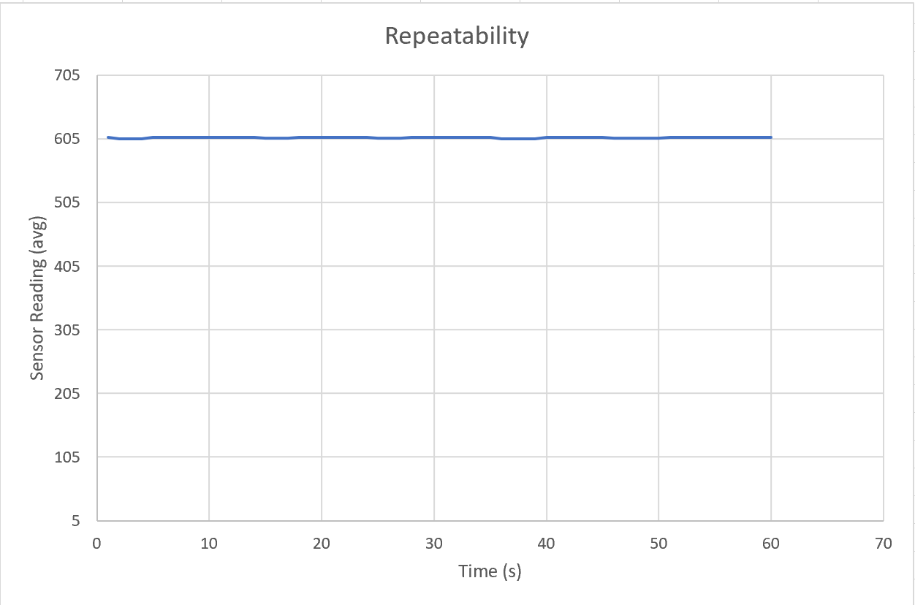
Repeatability

Slide 8
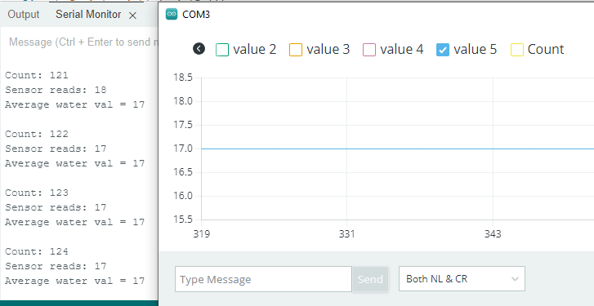
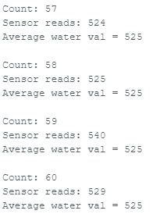
Drift
The sensor was left to gather readings in two states: in water, outside of water.
An average output was recorded to measure the output’s change over time.
Out of water drift: ~0%
In water drift: ~3.88%

Slide 9
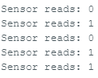
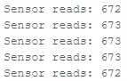
Range
Lowest Recorded Value(s)
The lowest output when the sensor was not in contact with water was recorded and compared to the highest output when the sensor was fully submerged in water.
Highest Recorded Value(s)

Slide 10
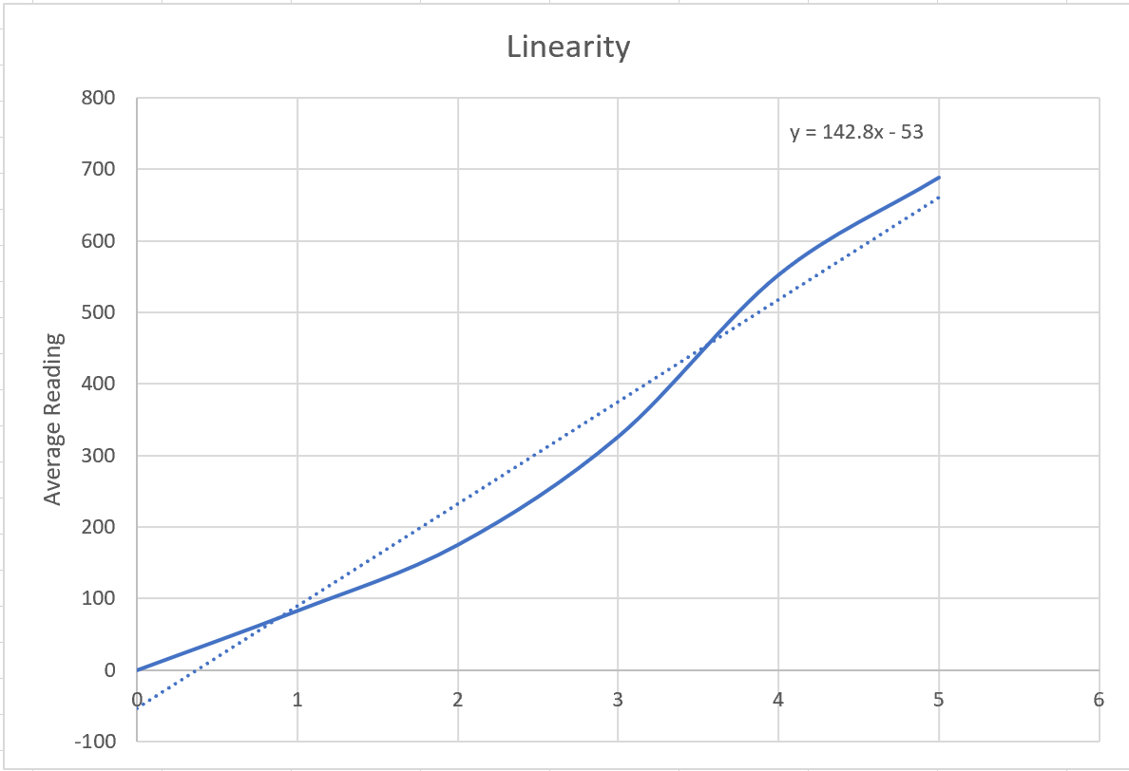
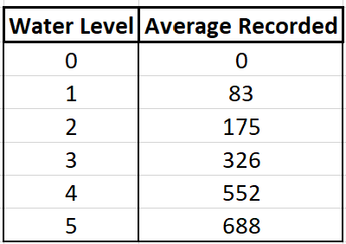
Linearity
Keystudio promotes this sensor as being extremely linear.
My data backs their claim up by showing the water sensor to be linear.
The non-linear readings can be attributed to difference in resistivity of the water tested.

Slide 11
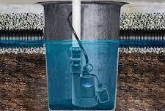
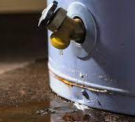
Novel Uses
Detect water level in sump pump
Detect if something like a water heater is leaking
Detect rainfall

